Slide 1
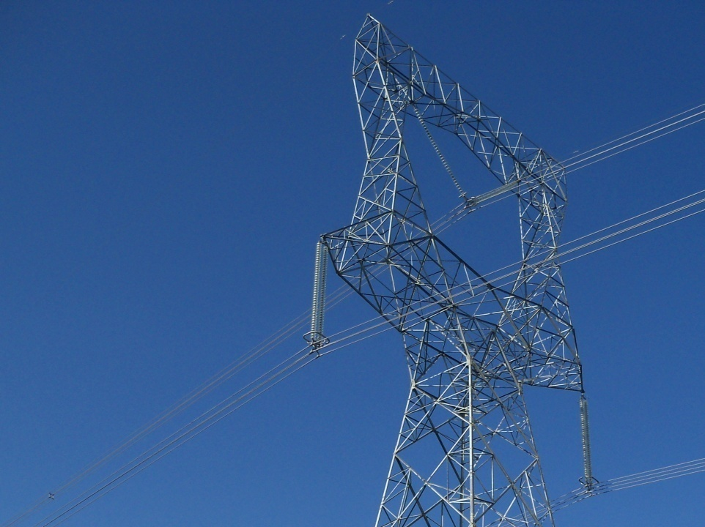
EMC Ltd.
Spanning power Globally
Since 1953

Slide 2
Index
Introduction
Industry Outlook
About EMC
Competition and EMC’s Position
Financials & Order Book
Future Roadmap

Slide 3
Vision & Mission
Our Vision
Setting the standard of excellence in modern power systems globally
Our Mission
Provide end-to-end integrated power system solutions globally
through Best-in-Class Technology, Quality and Safety
Continuous improvement of processes to ensure customer
satisfaction
Create an environment for our people to pursue excellence
through continuous learning

Slide 4
Introduction
Strong Foundation
“EMC Ltd.“ formerly known as Electrical Manufacturing Company Ltd.
Established in 1953
More than 6 decades of experience in the T&D sector.
Qualified for all segments in the T&D sector.
Offering complete turnkey solutions in power transmission systems and associated sub-systems.
In the elite group of companies qualified to execute 765kV transmission line projects and
up to 765kV sub-stations and industrial power systems.
Qualified to execute EHV Transmission Lines up to 400kV in leading European and African Countries
In-house manufacturing facilities: conductors and hardware along with towers & tower test bed.
A Leading Player
Strong Execution Capabilities
Built over 12,000 kms of transmission lines of up to 765kV.
Delivered large, complex projects across all voltage platforms and in challenging climatic and topographic conditions that include deserts, snowfields, seas, mountainous regions and thick forests as well as in exigent socio-political conditions including war-torn regions.
High Margin Business
Huge market opportunity in the premium 400kV – 765kV segment.
High entry barriers and minimal competition, therefore revenue and margins are high.
EMC among very few players (6-7) operating in this segment.
Talented Human Resource
Highly experienced professionals from the EPC industry.
It has a strong team of more than 150 talented engineers.
Organisational strength of over 1500 employees in total.
Being an established player in the Power Systems industry with turnkey solutions, excellent project execution and skilled manpower, EMC has great advantage over the new entrants and other established players in the sector.

Slide 5
Milestones & Achievements
1st Batch to sign PPA with NTPC Vidyut Vyapar Nigam Ltd. for setting up a 5 MW Solar Power Plant in UP under JNNSM
2011
Completed 400kV sub-station at Pirana for PGCIL
2011
Completed one of the first 765kV Single Circuit lines & bagged one of the first 765kV Double Circuit Line order in India
2009 - 2010
1st company in India to carry out stringing of OPGW in India
1995
1st company in India to obtain ISO certification for Transmission Lines
1994
Ventured into civil work for Coal & Ash Handling, Boiler erection at Power Plants
1983
1st company in India to supply 400kV Hardware Fittings & Accessories to NTPC
1980
1975
Hardware Fittings & Accessories division established
1973
1971
The 1st 132kV line in the Snow Zone above 9000 ft in Jammu & Kashmir
1969
Exported first lot of towers to Kuwait
Tower Testing station in Naini, Allahabad established
1967
1st company in India to have in-house Design facility
1960
1st Transmission Line tower factory was established
1955
Conductor factory set up followed by an Extrusion & Forging unit
1953
Company established

Slide 6
Recent Key Development
Acquired a Germany based company Cologne Engineering GmbH specialized in manufacturing of Roller Presses
Acquired Bangalore based company Quatro Rail Tech Solutions Pvt Ltd specialised in Executing Turnkey projects of Signalling, Telecommunication, Safety and security systems for Railways, & other Transportation systems, and Automatic Fare Collection Systems.
Company has become privately held after recently delisting from Calcutta Stock Exchange.
Acquired a USA based company Advanced Steel & Crane Inc. engaged in manufacturing and supply of transmission, sub-station & other structures at Tulsa, Oklahoma
Acquired a Italy based company named Tecnolines Srl. specialised in executing EHV Transmission Line projects on turnkey basis

Slide 7
Recent Key Development
Commissioned 5MW Solar Power Plant in Naini, Allahabad (India).
Successful entry into 765kV GIS Substation Segment.
Fitch Ratings took a positive rating action on EMC’s National Long-Term rating and Bank Loans rating
Upgraded EMC’s National Long-Term rating to ‘Fitch A-(ind)’ from ‘Fitch BBB+(ind)’ with Stable Outlook
EMC’s bank loans rating actions :
- Fund-based limit: upgraded to ‘Fitch A-(ind)’ from ‘Fitch BBB+(ind)’
- Term loan: assigned at ‘Fitch A-(ind)’
- Non fund-based limit : affirmed at ‘Fitch A2+(ind)’

Slide 8
Index
Introduction
Industry Outlook
About EMC
Competition and EMC’s Position
Financials & Order Book
Future Roadmap

Slide 9
Rapid Economic Growth
Rapid Economic Growth
Need Power for Sustained Economic Growth
Driving the Demand for T&D for Evacuation
Opportunity for EMC
Rapid Economic Growth (2006-13)
India is the one of the fastest growing economy in the world.
Source: RBI Economic Review 2012-13
Sustainable growth critically depends on the macro economic environment coupled with infrastructural development.

Slide 10
Need Power For Sustained Economic Growth
Rapid Economic Growth
Need Power for Sustained Economic Growth
Driving the Demand for T&D for Evacuation
Opportunity for EMC
Generation Capacity Addition (GW)
Trend in Per Capita Consumption (KWh) in India
(P) - projected
Source: CEA. *Working Group Report on Power for XIIth Plan
Source: IBEF Report (Sep 2009)
Current per capita consumption of electricity in India is at 779KWh (March 2012) vis-à-vis world average of approximately 2800KWh
Targeted per capita consumption of 1,000KWh by end of 2012.
Annual GDP growth rate of 8% necessitates a 9-10% growth rate in the power sector.
Per Capita Consumption (KWh) across the world
Source: Key World Energy Statistics (IEA)

Slide 11
Driving the demand for t&d for evacuation
Rapid Economic Growth
Need Power for Sustained Economic Growth
Driving the Demand for T&D for Evacuation
Opportunity for EMC
Status of Transmission Lines in Circuit Kilometers (cKms)
Drivers of T&D sector
Transmission Lines | At the end of 10th plan | 11th Plan additions (FY08-12) | 12th Plan addition Estimates (FY13-17)
765kV | 2,184 | 3,546 | 27,000
HVDC +/-500kV | 5,872 | 3,560 | 9,440*
400kV | 75,722 | 37,645 | 38,000
230/220kV | 114,629 | 25,535 | 35,000
Total Trans. Line | 198,407 | 70,286 | 109,440
Government mission “Power For All By 2012”
Requires large scale addition of regional and inter -regional transmission lines for evacuation.
The present investment in Generation and T&D Sector is 1:0.5 as against the desired ratio of 1:1.
GOI’s RGGVY scheme has targeted electrification of 100,000 villages providing electricity to more than 23.4 mn BPL families.
T&D losses on the higher side. (~35% avg)
GOI’s RAPDRP scheme has targeted to reduce these T&D losses from ~35% to 15%
*Includes HVDC +/- 800kV
Source: CEA , Working Group Report on Power for XIIth Plan
Anticipated requirement of transmission lines in EHV segment (above 400kV) will be 75,000 cKms in the 12th Plan.
Large investments expected in the T&D sector development in order to match the power generation capacity.
The sector has registered growth of 5.5% in 2011-12.

Slide 12
Driving the demand for t&d for evacuation
Rapid Economic Growth
Need Power for Sustained Economic Growth
Driving the Demand for T&D for Evacuation
Opportunity for EMC
India’s Expected Spending ($ bn) – T&D Sector
Transmission Utilities Business Scenario
Particulars | 10th Plan | 11th Plan | 12th Plan
Power Grid Corporation India Ltd. | 3.31 | 10.00 | 21.82
Private Utilities | 0.36 | 3.64 | 3.64
Other Central Utilities & State Utilities | 5.27 | 11.82 | 18.18
Total Spend for Transmission Line | 8.95 | 25.45 | 43.64
RGVVY | 1.76 | 2.96 | 5.45
APDRP | 3.09 | 9.38 | 5.45
Total Domestic Spending | 13.80 | 37.80 | 54.55
Power Grid (CTU) Business Scenario
Network presently carries over 45% of the total power generated in India; this is expected to increase to 60% by 2012.
Total 50 GW inter-regional power transfer capacity of 220kV & above targeted by the end of 12th Plan from existing 28 GW.
Adopted transmission system with higher voltages to cut losses.
State Transmission Utilities (STU) Business Scenario
Revamping and upgrade of existing transmission systems.
The majority of new projects are 400kV voltage ratings.
Unbundling of SEBs have occurred in 15 states.
Setting up high capacity intra-state power transmission systems to address rapid industrialisation and growing power needs.
1$=Rs. 55
Source: Crisi l & Company Research
Expected spending of $54.55 bn in the T&D Sector under the 12th Plan.
In the 12th plan PGCIL to spend $21.82 bn for enhancing the capacity of the interregional transmission grid and building a High Capacity Transmission Corridor (HCTC).
Huge plans for the inter-regional and intra-state power transfer capacity.

Slide 13
Opportunity for EMC
Rapid Economic Growth
Need Power for Sustained Economic Growth
Driving the Demand for T&D for Evacuation
Opportunity for EMC
An annual GDP growth rate of about 8%
Requires a 9-10% growth rate in the Indian power sector
Large scale addition of power generation capacity
Would necessitate large scale addition of power transmission capacity
Large scale addition of transmission capacity, at high voltage up to 1200kV, to minimize T&D Loss
Being a turnkey solution provider and one of the top 6-7 players qualified for high voltage projects provides EMC an immense growth opportunity
Private companies entering into power generation
Will require specialised players like EMC for setting up transmission lines up to 1200kV for evacuation
Demand for upgrade of existing transmission lines
A new market for EMC

Slide 14
Opportunity for EMC in india
Rapid Economic Growth
Need Power for Sustained Economic Growth
Driving the Demand for T&D for Evacuation
Opportunity for EMC
This effectively translates into a large universe of $54.55 bn in the T&D Space alone over the next 5 years (2012 -17); thus leaving room for all major players in this space
Power Opportunity
Generation
Transmission
Distribution
Transmission Line
Substation
Tower Package
Conductors
Others
Transformer
Others
($90.00 bn)
($43.64 bn)
($72.73 bn)
(60%)
(40%)
(60%)
(50%)
(25%)
(50%)
(15%)
*1$=Rs. 55
14

Slide 15
Opportunities in the Global Transmission Sector
T&D Investments Globally Over 2011-35E (US$ bn)
Opportunities in the International Market
International market growth drivers:
Interconnection projects and transmission projects for new generation capacities
Replacement demand in the next 5-7 years
International Energy Association (IEA) - World electricity demand to grow to 34,352 TWh from 17,217 TWh at 2.7% CAGR over 2009-35.
IEA - approximately 42% of investments would be made in power T&D projects over 2010-35.
Key international markets will be: South Asia, the Middle East, Africa and North America, which are at different thresholds of power capacity addition.
To support this massive electricity demand, global generation capacity is expected to reach 9,000 GW by 2035 from 5134 GW in 2010, which would require US$ 7.1 tn investments in the T&D sector over 2010-35.

Slide 16
International Markets
Focus Regions | Expected Market ($ bn)*
Europe | 182
North America | 160
South America | 200
Asia & Middle East | 300
Africa | 150
Total (Approx) | 1,000
*Expected till 2020-22

Slide 17
Europe
In Europe, approx €140bn ($182bn) is required for the development of High Voltage Transmission Systems, Storage & Smart Grid applications by 2020.
Despite the negativity in Euro Zone’s investment climate, many countries have plans to lay new lines or upgrade its existing infrastructure.
As countries switch from coal and nuclear power to cleaner and renewable energy, new plants would demand new lines to evacuate power to consumers.

Slide 18
Europe
List of some of the Projects Expected in Europe:
Project Type | Country | kV Rating | Value ($ bn)
New Power Network (2025) | Sweden | Various | 9.3
450km Transmission Line | Norway | -- | 9.3
New Transmission Lines | Italy | 132-380kV | 9.1
Strengthen Transmission System | Spain | Various | 1.8
Development & Renewal of Network | France | 400kV | 1.7
Lines & Substations (New & Upgrades) | Poland | 220-400kV | 0.6 per year
New Lines (4,000 kms approx) | Germany | 400kV | --

Slide 19
NORTH America
NERC 2017 report indicates 10% growth in new transmission lines in US and 7.5% growth in Canada.
Various networks in the US and Canada are up for renewal.
Upgrades include increasing voltage of transmission lines to new tower packages.
Also the continent is seeing increasing use of renewable energy power plants in its bid to switch to cleaner sources of fuel.
Shift to renewable energy and the increasing importance of Shale Gas as an energy substitute will demand an increase in new lines from new power plants.
~$160bn of investments are expected in the North American T&D space.

Slide 20
North America
New and Renewal Interstate Transmission Projects in United States with an estimated value of $26.5bn (~16,000 kms) are expected by 2026.
List of some of the Projects Expected in United States:
Project Type | Voltage Rating | Value ($ bn)
Northeast Energy Link | Various (HVDC) | 2.0
RITELine | 765kV | 1.6
Susquehanna – Roseland Project | 500kV | 1.3
Grand Rivers Project | 345kV | 1.3

Slide 21
North America
Project Type | kV Rating | Value ($ bn)
Upgrade of Transmission N/W (2017) | Various | 9.0
Upgrade of Transmission N/W (2018) | Various | 0.7
Utility Infrastructure Improvement | Various | 0.6
Network Strengthening in Montana, Virginia and Connecticut | Various | 0.5
Northern Pass Transmission Project | 345kV | 1.1
Great Northern Transmission Line | 345 – 500kV | 1.0

Slide 22
South America
South America’s electricity consumption is expected to grow 2.9% p.a. to ~2,500TWh by 2035, double from current level.
Brazil’s Electricity Market is the largest in South America. As the majority of power generation in the country is hydro-based, there is need for new power plants of various fuels to ensure uninterrupted power supply.
This requirement necessitates new power transmission lines.
Peru is expected to spend $470mn as part of its 2013-18 Binding Plan for new and existing repowering power lines.
Countries like Argentina, Chile, Colombia and Ecuador too have planned various new lines and upgradation of its existing lines.

Slide 23
South America
List of some of the Projects Expected in South America :
Project Type | Country | kV Rating | Value ($ bn)
7,000 km of Lines & Substations | Brazil | 500kV | 2.8
600 km Lines / 8 Substations | Ecuador | 500kV | 0.9
New and Existing Line Upgrades | Peru | 220kV | 0.5
Peru-Ecuador Interconnection Upgrade | Peru | 500kV | --
High Voltage Grid Expansion | Chile | -- | 0.2
Double-Circuit Line Projects | Colombia | 500kV | --

Slide 24
Asia & Middle east
With some of the world’s fastest growing economies present in this region, there is a constant demand for power.
Demand shortages and poor infrastructure are the main issues plaguing the electricity sector in this region.
Asia Electricity Demand is projected to grow 3.4% p.a. to ~15,000TWh by 2035, nearly doubling from ~7,000TWh in 2010.
Asia will account for ~60% of World Electricity Demand growth to 2035 and account for ~50% of World Electricity Demand.
As countries bridge the generation gap, there will be ample market opportunities for new transmission lines and upgrading existing lines. Demand for associated substations will also increase.

Slide 25
Asia & Middle east
According to IEA, Middle East electricity consumption is expected to increase to 1,353TWh by 2030 (CAGR ~4%).
With 238GW of capacity expected to power this region, a substantial demand for new and upgrading existing transmission lines will follow.
Plans to develop interconnecting networks in the region. The North Grid linking Saudi Arabia, Qatar, Kuwait, and Bahrain has been completed (Phase I).
In Phase II, UAE and Oman will be linked as part of the South Grid, and in Phase III, the North & South Grid will be linked.
Saudi Arabia is expected to invest ~USD 140bn in its Generation and Transmission infrastructure by 2020.

Slide 26
Asia & Middle East
List of some of the Projects Expected in Asia (ex. India), and Middle East:
Project Type | Country | kV Rating | Value ($ bn)
Saudi – Egypt 1,400 km Grid | S. Arabia | 500kV | 1.5
Grid Upgradation | Philippines | -- | 1.2
Transmission System Expansion | Qatar | -- | 1.0

Slide 27
Africa
Africa’s electricity consumption is expected to grow 5.7% p.a. to 3,188TWh by 2040.
Eastern African Power Pool (EAPP) was established by the countries in East Africa to promote power supply in the region, develop the electricity market, reduce costs, and increase investments in the region.
Countries participating in EAPP include the Nile Equatorial Lake Countries (Democratic Republic of Congo (DRC), Burundi, Kenya, Uganda, Rwanda), Egypt, Ethiopia, Sudan, Tanzania, & Djibouti.
A number of interconnection projects have been planned as part of the EAPP constituting ~10,500 km of lines with voltage range of 220-600kV (including 500kV and 600kV HVDC Bipoles).
The financing for the Eastern Electricity Highway Project connecting the grids of Kenya and Sudan (part of EAPP) has commenced. The total project cost is ~$1.3bn.

Slide 28
Africa
Notable Projects of EAPP | kV Rating | Length (km) | Capacity (MW)
Ethiopia – Kenya | 500 HVDC | 1,120 | 2,000
Egypt – Sudan | 600 HVDC | 1,665 | 2,000
Ethiopia – Sudan | 500 | 570 | 3,200
Uganda – Kenya | 220 | 254 | 300
On a similar note, the West African Power Pool (WAPP) & South African Power Pool (SAPP) have been envisioned to connect energy sources to countries in these respective regions.
Countries part of this project include Democratic Republic of the Congo, Angola, Namibia, Botswana, South Africa, Malawi, Mozambique, Zambia, and Zimbabwe will also be brought under this project soon.
WAPP entails ~3,000 kms of lines of 400kV HVAC lines and is estimated to cost ~$6.5bn. SAPP is expected to cost ~$5.6bn.

Slide 29
Railways – Market Potential (India)
Nearly ~44,000 kms of existing lines need to be electrified. The potential value of these projects is approx $3.1bn.
~6,000 kms of rail electrification projects expected in the next 5 years ($530mn)
~6,000 kms of projects expected as part of the Dedicated Freight Corridor.
Nearly 1,076 kms of Electrification, Signalling & telecom work valued at almost $680mn for various Metro Rail projects across India
Metro Rail projects are expected across 29 cities in India over the next few years.
Electrification, Signalling & Telecom, Track Laying including major and minor bridges enroute valued at almost $660mn in the next 3 years under RVNL
In the next 5 years the business potential for Railway Electrification, Signaling & Telecom and other works is nearly $2bn (excluding DFCC projects)
Sample Railway Projects Expected in India soon:
Project Type | Client | Value ($ mn)
Railway Electrification ~1,000 kms | CORE | 87
Substations, Electric Works, OHE (UP / Bihar) | DFCCIL | 71
Railway Line Doubling (AP) | RVNL | 115
Metro Railway Construction (Kolkata / Mumbai, etc.) | SPVs | 680

Slide 30
Railways – Market Potential (India)
Few Metro Projects Coming Up in India:
Client | Route Kms | Value ($ mn)
KMRCL ( Kolkata) Phase II, Phase III & Phase IV | 200 | 150
MMRCL (Mumbai), RIL Consortium Phase II | 311 | 215
JMRCL (Jaipur) | 35 | 20
BMRCL (Bangalore) | 47 | 15
CMRCL (Chennai) | 96 | 24
Ahmedabad Metro | 163 | 81

Slide 31
Index
Introduction
Industry Outlook
About EMC
Competition and EMC’s Position
Financials & Order Book
Future Roadmap

Slide 32
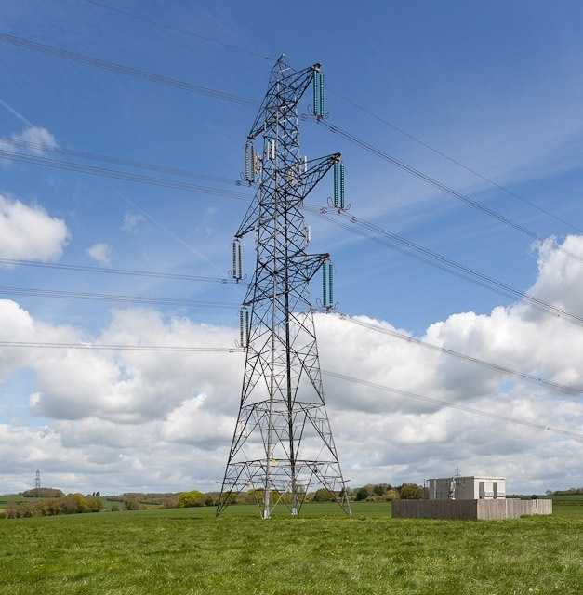
Transmission Line Projects

Slide 33
Operating Segments (1/6)
Transmission Line Projects
Turnkey solutions in transmission line projects up to 765kV and ready for 1,200kV projects
Activities
Supply Contracts:
Transmission line towers including Bolts & Nuts and Tower Accessories, Line Hardware, Insulators and Earth-wire.
Construction Activities:
Survey, detailed soil investigation, civil construction of foundations, erection of towers, stringing of conductors and testing & commissioning of line.
Supplied over 450,000 mt of Towers including 40,000 mt overseas.
Built over 12,000 kms lines for many utilities in India and abroad including Power Grid, NTPC, DVC, various State Utilities etc. Presently executing 30 orders of 400kV & 765kV of over 150,000 mt of Towers and 2550 kms of lines.
765kV: Completed S/C Seoni – Mewad TL of 134 kms. Currently executing 9 contracts of over 1400 kms for PGCIL.
400kV: Completed over 4,000 kms and currently executing 8 lines of over 1,150 kms.
Up to 220kV: Completed over 5,700 kms, of which approx 1,200 kms are outside India.
Through its subsidiaries currently executing one 400kV transmission line project of over 40kms in Finland and one 300kV D/C transmission line project of over 70kms in Sweden
Key Projects Undertaken
Features
First ISO-9001 certified company in India in transmission line projects
Also has been accredited with ISO 14001 certification by KVQA
Qualified to execute 765kV transmission line projects
One of the leading Indian EPC player qualified for overhead Extra High Voltage transmission line up to 765kV

Slide 34
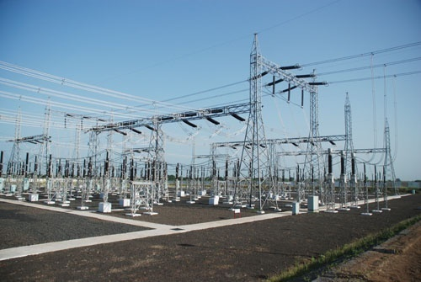
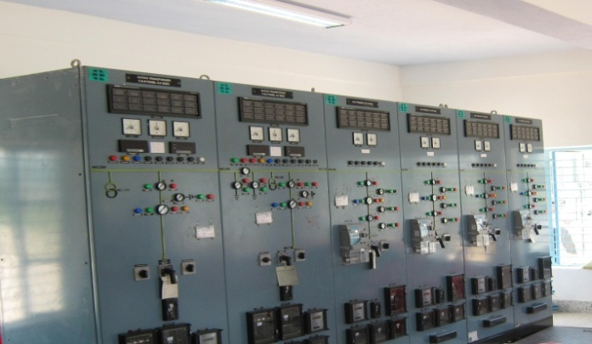
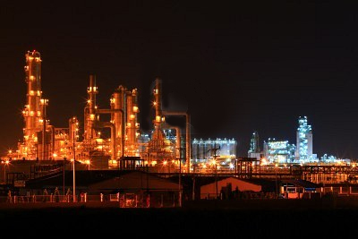
EHV Substations / Distribution System / Industrial Power Distribution System
EHV Substations
Distribution System
Industrial Power Distribution System

Slide 35
Operating Segments - (2/6)
EHV Substations / Distribution System / Industrial Power Distribution System
Operating Segments
EHV Substations
Distribution System
Industrial Power Distribution System (IPDC)
EHV Substation projects up to 400 and 765kV
Supply contracts for major equipments & Auxiliary Systems of substations
Construction activities including erection, testing & commissioning as EPC contractor
33 / 11kV HT/LT Substation & Distribution line up to consumer metering
Supply of equipments
Construction including erection, testing & commissioning as EPC contractor
Load Distribution Centre (LDC)
Underground tunneling & electrical cabling & cable bridge
PLCC & SCADA installation,
Ventilation & A/C Systems
Plant illumination Electrification, Street Lighting
Activities under each Segment
Supply of equipment & materials and construction of 400 / 220kV Pirana Substation with 12 bays for PGCIL as EPC contractor.
The work includes Civil construction / Control Room Building / Fire Fighting system etc.
Rural electrification work in Nawada, Jehanabad and Arwal districts of Bihar having 15 substations (33 / 11kV) for BSEB through PGCIL under RGGVY Scheme.
The work also includes consumer metering in over 1200 villages.
Civil & electrical contract for IPDC project of SAIL - IISCO’s steel plant at Burnpur in a JV with Areva (Areva scope limited to supply of their own equipments),13 sub-stations, 10 LDCs and over 5 kms of underground concrete tunnels for cable laying and 2 kms. of cable ridges, 27,000 cu.mtrs RCC work.
SCADA & Automation
Projects Undertaken

Slide 36
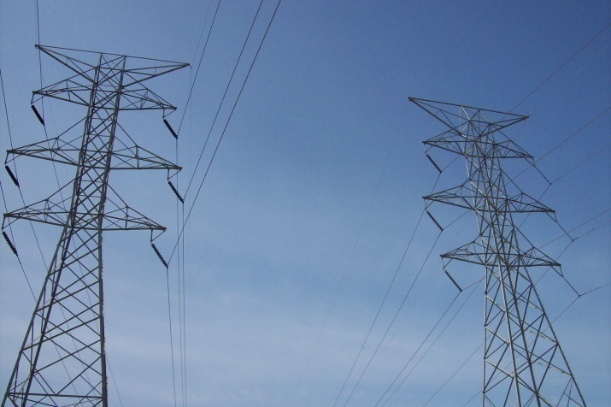
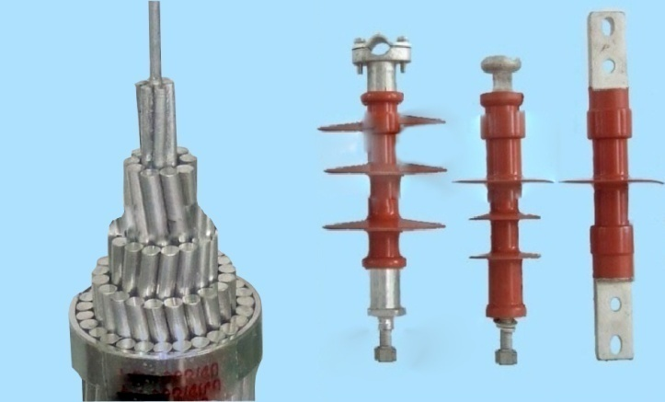
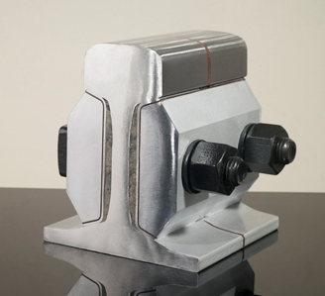
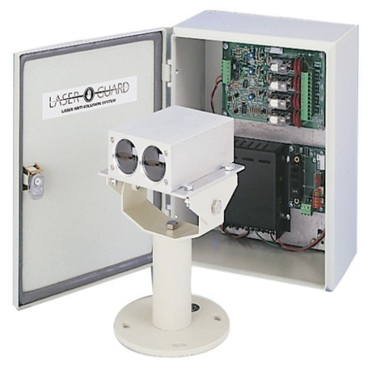
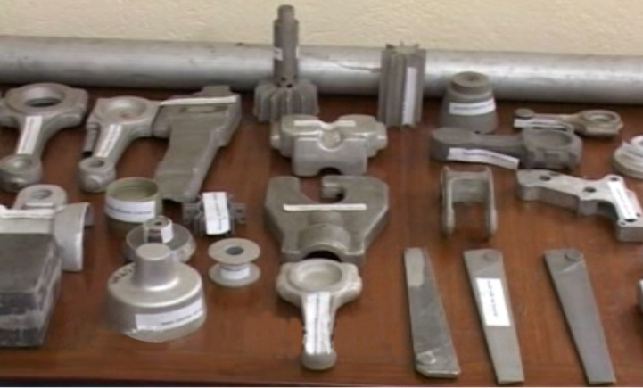
Manufacturing activities
Towers
Hardware & Conductors
Signaling & Safety Products
Auto & Defence Components

Slide 37
Operating Segments (3/6)
Manufacturing Activities
Operating Segments
Towers/ Structures
Hardware
Conductors
Manufacturing facilities located at Kolkata & Naini in India and Tulsa, Oklahoma in USA have best in class plant and technology that includes CNC machines and a galvanizing plant
Manufacturing of hardware fittings, and accessories suitable for overhead power transmission lines.
Manufacturing of bare conductors and conductor accessories suitable for overhead power transmission lines.
Activities under each segment
Manufactured & supplied over 350,000 mt.
Currently over 150,000 mt of orders in hand.
Hardware Fittings & Accessories – 1st company in India to supply hardware fittings to NTPC
Conductors – manufactured & supplied over 30,000 kms including 7,000 kms of 61 strands ACSR “Moose”.
Projects Undertaken

Slide 38
Operating Segments (3/6)
Manufacturing Activities
Operating Segments
Signaling & Safety Products
Alloy Forging & Machine Products
Signaling Systems
Security & Surveillance Systems.
Selective Telephone Systems
Intrusion Detection and Access Control.
Anti Collision Device Systems
Manufacturing quality non-ferrous alloys, extrusions & forging and special aluminum alloy / copper components. Factory at Agarpara near Kolkata.
Activities under each segment
Currently executing order of indoor signaling system for Adani Rail Project and Signaling system, Chittagong, Bangladesh awarded by Ansaldo.
Auto & Defence
Currently executing orders for Bajaj Auto, MACO Pvt. Ltd. LML Ltd.
Ordnance Factories / Gun & Shell Factory, Rifle Factory, Small Arms Factory
Projects Undertaken

Slide 39
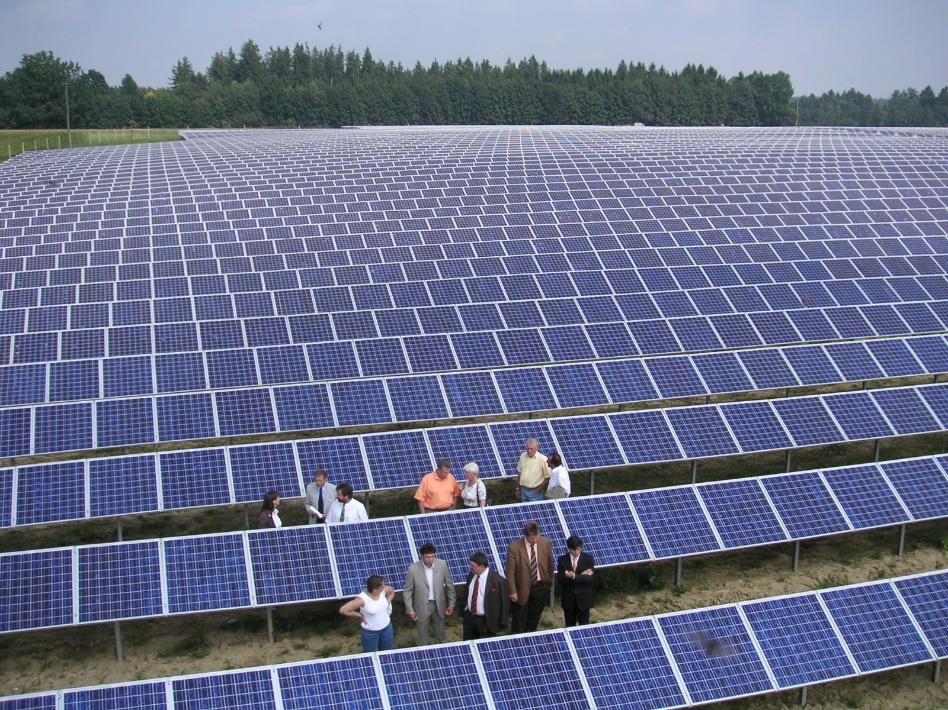
Solar power

Slide 40
Operating Segments (4/6)
Solar Power
Activities
Committed to green power having commissioned a 5 MW Solar power plant at Naini, Allahabad.
Successfully commissioned on March 04, 2012. under GOI’s Jawaharlal Nehru National Solar Mission (JNNSM).
Has been selected against very tough competition among 400 participants and has already signed a Power Purchase Agreement (PPA) with NTPC Vidyut Vyapar Nigam Ltd. ensuring sale of power for the next 25 years.
The plant is environment friendly and will provide sustainable & renewable energy.
The first solar plant of its kind in the state of Uttar Pradesh, India.
EMC also to gain the benefits of ‘Carbon Credit’ from this plant.
Features

Slide 41
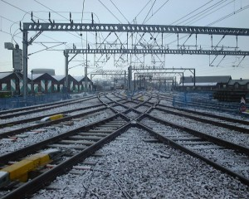
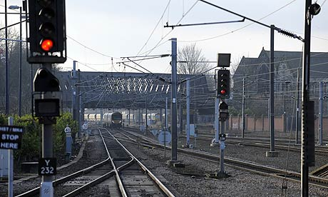
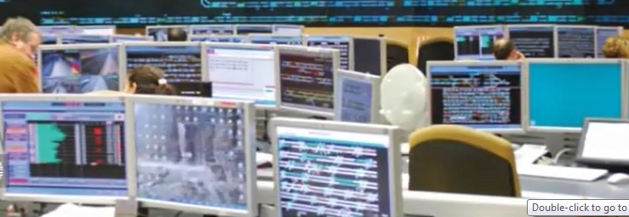
Railway Infrastructure
Railway Electrification
Signaling, Telecommunication, Safety & Security Systems
SCADA
Civil & Track works

Slide 42
Operating Segments (5/6)
Railway Electrification / Signaling
Operating Segments
Railway Electrification, Signaling, Telecommunication, Safety & Security Systems and Civil & Track Works
Over Head Electrification (OHE), Traction Substation (TSS) & associated SCADA systems and General electrical work
Signaling, Telecommunication, Safety & Security System: design, engineering, , installation, testing, commissioning, maintenance and development of technologies
Automatic Fare Collection Systems
Construct bridges, buildings (at stations & yards), platforms, etc. & Track works
Activities under each Segment
Awarded on Turnkey Basis 25 kV, 50 Hz, Single Phase OHE including TSS, SCADA & Electric General Works in Vizianagaram - Singapur Road for 138.84 RKM / 369 TKMs & in Kumedpur–Old Malda & Old Malda – Singhabad for 79 RKM/168 TKMs
Pre-qualified along with JV partner GCF SpA for OHE, substation & SCADA systems for Delhi Mass Rapid Transport System (Phase #3) for U/G stations.
Through it Subsidiary EMC is currently providing Signaling & Telecommunication consultancy to various clients like Adani’s for Sarguja Rail Corridor Project and Chittagong railway station Project, Bangladesh
Projects Won / Bid
Partnerships
Company would soon formalise partnerships through binding agreements with leading global companies on future cooperation for Railway infra projects

Slide 43
Operating Segments (5/6)
Quatro Rail Tech Solutions Pvt Ltd, Bangalore (India)
Quatro Rail Tech Solutions Pvt Ltd (QRTS) provides Signalling, Telecommunication Safety, Security and Train Diagnostic solutions for the Railways and Transportation domain in general.
EMC is the majority shareholder (60%) of (QRTS)
Company provides design, engineering, supply, installation, testing, commissioning, maintenance, trading, innovation and development of technologies in the areas of Signalling, Telecommunication, Safety and security systems in the domain of Railways and Metro systems
Automatic Fare Collection Systems(AFCS), OHE and other Railway and Metro related systems.
The Company is currently providing Signaling & Telecommunication consultancy to various clients , execution of turnkey signalling solutions to Indoor systems of four stations of Adani’s Sarguja Rail Corridor Project in the state of Chattisgarh and design, engineering and project management and execution& commissioning of Signaling System and turnkey execution of telecommunication system of Chittagong railway station, Bangladesh

Slide 44
Operating Segments (5/6)
Railway Infrastructure Projects
Current Status of EMC in Railway Business initiated 9 months ago.
SN | Tender details | State | Client | Value ($ mn) | Status
1 | Design, Detail Engineering, Manufacture, Supply, Installation, Testing and Commissioning of 25kV AC TRACTION (RIGID OHE) AND Auxiliary Sub Station (ASS) and associated SCADA systems for U/G stations of Delhi Mass Rapid Transport System Project Phase-3 (Contract Package: CE-08 Lot 1-Lot2) | Delhi | DMRCL | 58.58 | Tender Submitted. Awaiting Results
2 | Design, Supply, Erection, Testing & Commissioning of 25 KV, 50 Hz, Single Phase Over Head Equipment including TSS, SCADA & Electric General Works on Turnkey Basis in Vizianagaram (Excl.) - Singapur Road(Incl.) Section, Gr.166 of Waltair Division of East Coast Railway under RE Project Bhubaneswar, Total 138.84 RKM / 369 TKMs. | Andhra Pradesh | CORE Allahabad | 15.06 | Under execution.
3 | EOI for Supply, Installation and Commissioning of Power Supply and Traction Electrification System | Gujarat | MEGA | 23.51 | Qualified in the Pre Qualification Stage
*1$=Rs. 55

Slide 45
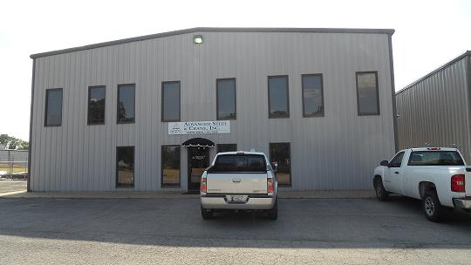
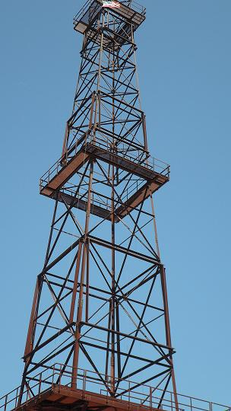
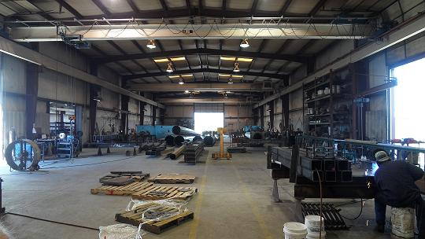
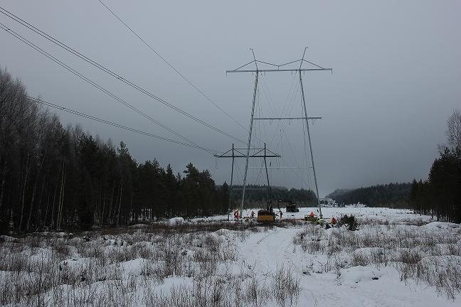
International business

Slide 46
Operating Segments (6/6)
International Business- NORTH AMERICA
Advanced Steel & Crane Inc., Tulsa, Oklahoma, USA
Since 1970, Advanced Steel & Crane, Inc. has provided Substation steel structures and components to major Electrical Utilities as well as many Rural Electric Cooperatives across the United States and Canada.
Today this company serves electric utilities by supplying transmission and sub-station structures and components. They also cater to general fabrication and metal processing needs.
Facilities:
6 Buildings of total square footage of 28,117 sq. ft. on approximately 4 acres of property including 2 fabrication areas.
Several Galvanizing facilities exist nearby.
Product line:
Utility Substation Steel Structures- Structural Distribution/Transmission Steel & Lattice Products, square, round, folded plate or aluminum, with shop assembly if needed.
Anchor Bolts and Cage
Customers: More than 70 customers, mainly utilities across North America.

Slide 47
Operating Segments (6/6)
International Business - EUROPE
TECNOLINES S.r.L., Italy
Established in 1956, Tecnolines Srl. (“Company”) specialises in executing EHV Transmission Line projects on a turnkey basis.
EMC is the majority shareholder (70%) of Tecnolines. The balance is held by RDF Group (Italy).
Tecnolines specializes in providing EPC services for Transmission lines ranging from 110-400kV.
Tecnolines has certified manpower <>, and sufficient equipment with centralized workshop at Pordenone (near Venice), Italy.
Tecnolines is pre-qualified in all Utilities across Europe (including Scandinavian Countries) and Africa.
Tecnolines in association with its partners is currently executing one 400kV transmission line project in Finland and two DC transmission projects (300kV and 400kV) in Sweden.

Slide 48
Operating Segments (6/6)
International Business - EUROPE
Cologne Engineering GmbH, Germany
Cologne Engineering GmbH is one of the specialized companies in Germany for manufacturing of Roller Presses
It provides the offering to its clients in Oil & Gas, Mining, Mineral and Cement Industry in the fields of Independent contract Manufacturing, Consulting and related Services
The company boasts of a team of more 130 professionals having experience in various segments of precision engineering fabrication
Previously, It was part of production unit of KHD Humboldt Wedag AG - one of the global market dominating companies, known for supplying plants for cement- and minerals- industry
Location: Cologne-Kalk with a production area of approx. 40.000 m²

Slide 49
Operational Value Chain
Provides T&D solutions and BOP for EPC Projects.
EPC Projects
1
Transmission
2
Distribution
3
BOP
Manufactures Towers, Hardware and Conductors suitable for EPC Projects .
4
Manufacturing Towers, Hardware and Conductors
Scrap from manufacturing and EPC Projects used as raw material for Defence & Auto Components unit.
Scrap
5
Manufacturing Defence and Auto Components
Optimally utilising facilities through five operating divisions to provide turnkey solutions and maximise revenues.

Slide 50
Project Presence - India
Rajasthan
Jammu & Kashmir
Uttar Pradesh
West Bengal
Gujarat
Bihar
Tripura
Jharkhand
Madhya Pradesh
Orissa
Maharashtra
Mizoram
Chhattisgarh
Karnataka
Manipur
Tamil Nadu
Kerala
Nagaland
Arunachal Pradesh
Andhra Pradesh

Slide 51
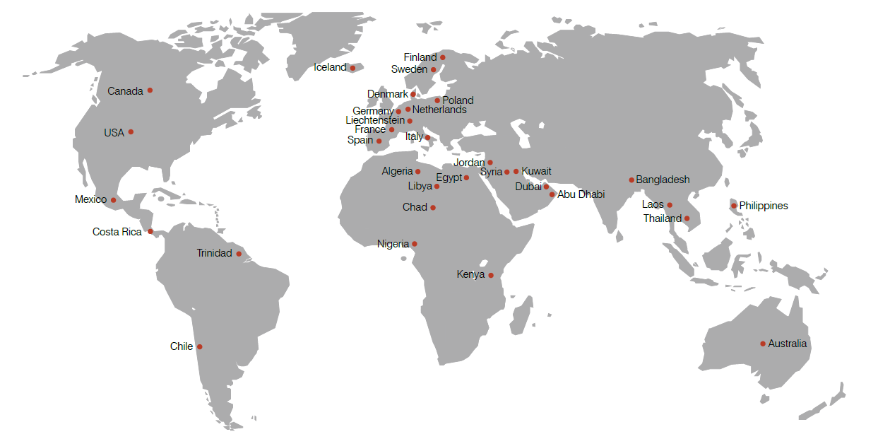
Project Presence - Overseas

Slide 52
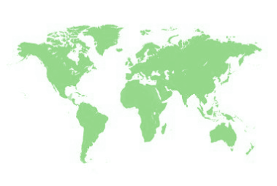
Global Offices
London, UK
Vrigstad, Sweden
Tulsa, USA
Pori,
Finland
Delhi, India
Kolkata, India
Hong Kong
Hyderabad, India
Singapore
Cologne, Germany
Mumbai, India
Venice, Italy
Dubai, UAE
Nairobi, Kenya

Slide 53
Key Management Team
Mr. S L Dugar
Non-Executive Chairman
Prominent industrialist, entrepreneur & philanthropist
Over 30 years of experience
Has a stake in EMC.
Mr. Manoj Toshniwal
Managing Director
Prominent entrepreneur
Over 20 years of experience.
Has in-depth knowledge and understanding of the Power Industry.
Mr. Ramesh Chandra Bardia
Joint Managing Director
Prominent entrepreneur
Over 35 years of experience in investment and finance Industry.
Involved with many financial institutions as a promoter.
Mr. Suraj Mall Singhi
Non-Executive Independent Director
Over 45 years in manufacturing and power sector.
Held very senior position in Fort Gloster Industries Ltd.
Also Director at JDS Trade Links Pvt Ltd. and General Investment Company Ltd.

Slide 54
Key Management Team
Mr. Saubir Bhattacharyya
Non-Executive Independent Director
Over 40 years of experience and expertise in business, administration, customer service, human resource management for renowned companies like SBI.
On panel of special directors of BIFR, arbitrators MCX Ltd & NSE Ltd and on the board of STESALIT Ltd.
Member of Circle Credit committee.
Held position of Chief Operating Officer of The Calcutta Stock Exchange Ltd.
Mr. D P Sharma
Executive Director,
Finance & Audit
Over 40 years of professional experience in very senior positions in some of the leading engineering & steel companies like HDC & Usha Martin.
Mr. Subroto Chaudhury Executive Director
Holds over 34 years of professional experience in very senior positions in some of the leading MNCs and Indian Companies in infrastructure industry
Is on Board of various companies like Quatro Railtech Solutions Private Limited, Bharat BPO India Ltd etc.
Mr. Manish Agarwal
Non-Executive Director
Holds over 18 years of professional experience in International & Domestic Financial and Banking field across various sectors like Infrastructure, Natural Resources, Urban Development, Manufacturing , Services & Social Enterprises, etc.
Is on Board of various companies like Leverage Capital International LLC , Oxley Group, Anjali Microfinance Pvt. Ltd etc.
Holds Professional Memberships of many reputed industry bodies like Confederation of Indian Industry (CII).

Slide 55
EMC GROUP STRUCTURE
EMC LIMITED
Subsidiary Companies
Offices
Manufacturing Units
EMC Academy Ltd.
HQ Kolkata
Mumbai
New Delhi
Agarpara Works (Kolkata)
EMC West Asia JLT Dubai
Hyderabad
Bangalore
Beliaghata Works (Kolkata)
Advanced Steel & Crane Inc. USA
Nairobi
Venice
Dubai
Tulsa, OK
Tecnolines S.R.L. Italy
Naini Works (Allahabad)
Vrigstad
London
Pori
EMC Overseas Ltd. India
Singapore
Hong Kong
Solar Farm (Allahabad)
EMC Hardware Ltd.
EMC Towers Ltd.
Cologne Engineering GmbH, Germany
EMC Forging Ltd.
Tecnolines Pte Ltd, Singapore
Quatro Rail Tech Pvt. Ltd.
EMC East Asia Ltd, Hong Kong

Slide 56
Top Clients
Power Grid Corporation
of India Ltd.
Transmission Corporation of
Andhra Pradesh
Indian Iron and
Steel Company
Maharashtra State Electricity Transmission Co. Ltd.
Steel Authority of
India Ltd.
Central Organisation for Railway Electrification
NTPC Ltd.
Delhi Metro Rail Corporation Ltd.
Ameren Corporation, USA
Fingrid Oyj, Finland
Svenska Kraftnat, Sweden
Rural Electrification Authority, KENYA

Slide 57
One-stop Shop For Turnkey Solutions and synonymous with timely execution
EMC Advantage
EMC offers total turnkey solutions, complete with design, engineering, electrical,
mechanical & civil works and associated auxiliary systems for:
Transmission
Transmission lines up to 765/800 kV
Sub-stations up to 400 kV
Distribution
HT/LT distribution in the industrial sector
LT distribution in rural areas and rural electrification up to consumer metering
Balance of the plant (BOP)
Both EHV sub-station and plant electrification for integrated steel & power plants
Illumination packages for area and production units
Railway Infrastructure
Overhead Electrification
Signaling & Telecom
Traction Substations
Track Laying
General Electrification
Our
Sectors
Product Lines
Transmission Line Towers
Conductors
Insulator Hardware Fittings and Accessories
Performed Line Products
Non-ferrous Extrusion, Forgings and Die Casting
Power Transmission Sectors
Industrial Sectors
Defense Automobiles
Railways

Slide 58
What Is The EMC Advantage?
Over 6 decades of professional experience
Leading turnkey power solutions provider
One of few companies in India capable of undertaking and successfully executing extra high voltage projects
Offers comprehensive turnkey solutions with design engineering, erection, testing and commissioning, including all auxiliary systems such as lighting & illumination and fire protection systems
One of few Indian EPC players qualified and executing Gas Insulated Sub-stations (GIS) projects on turnkey basis
In-house facilities to design and manufacture:
Towers
Conductors suitable for power transmission and distribution
Insulator hardware fittings and accessories
Non-ferrous extrusion, forgings and die castings
Design and Testing of Towers for Destruction Tests and having in-house Test Bed
Constructed over 12,000 kilometers of transmission lines of up to 765 kV
Consistently exhibited strong time-bound execution capabilities both domestically and abroad
One of few Indian EPC players qualified in 765 kV transmission lines & now poised to enter 1200 kV segment
EMC through its subsidiary is qualified to execute of EHV Transmission Lines upto 400kV in leading European and African Countries
Foray in to Railways business in the following areas: Projects of Indian Railways (all zones and divisions) on turnkey basis, Metro Rail Projects including Mono Rail & Dedicated Freight Corridor

Slide 59
Corporate Social Responsibility
The Company’s CSR activities involve:
Environment
Education
Rural development
Local Area Responsibility
Working in “Clean Energy” in the industrial area of Naini near Allahabad by setting up a Solar Power plant.
EMC Academy has been set up in Kolkata to create a large pool of supervisory talent & for imparting technical education in the field of power systems.
In its projects, EMC adopt the villages wherein they provide:-
Bore wells
Primary schools
Drinking water
Beautification of the surrounding area near the factory, including plantation of trees.

Slide 60
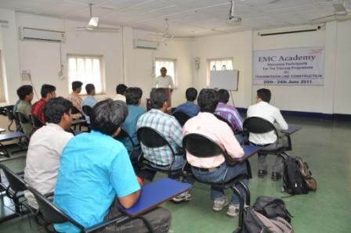
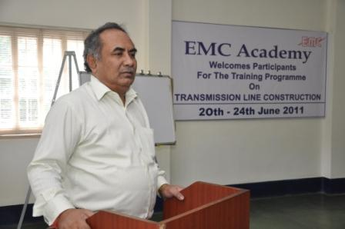
EMC Academy
Genesis
The EMC Academy is an endeavour to establish a unique institution dealing for professional development of Engineers, Supervisors & workforce ito meet growing need of Trained Manpower in power sector
Established in June 2011 is dedicated towards bridging skilled manpower shortage in the Transmission and distribution (T&D) sector
Well equipped with all modern audio visual aids and has a capacity to train 1,600 students per annum
Imparts training in different discipline like Environment Management, Civil Design and Quality Control, Planning of Power Systems, Quality Management, Safety Management, Behavioural Management extending to the students, industries and Government agencies
Has already conducted various training programs for its employees
We believe this initiative will meet the ever-growing business needs of our company and create the industry leaders of tomorrow
Features

Slide 61
Index
Introduction
Industry Outlook
About EMC
Competition and EMC’s Position
Financials & Order Book
Future Roadmap

Slide 62
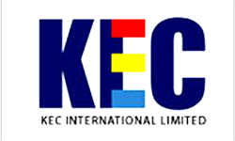
Peer Profile
Kalpataru Power Transmission Limited:
Product Profile: Power Transmission & Distribution, Cross Country Pipeline, Oil & Gas field Surface Facilities, Civil Infrastructure Projects, Power Generation (biomass) as well as Railway projects.
Public listed company based at Gandhinagar Gujarat with a Turnover of $ 1,106.4 mn for FY13 & annual installed capacity of 180,000 MTs. of Galvanized Steel Towers. As on March 31, 2013, the company has a consolidated order book of above $ 2,254.6 mn.
KEC International Limited:
Product Profile: Power Transmission, Power Systems, Cables, Railways, Telecom and Water. Power Transmission is the largest vertical of the company.
Public listed company based at Mumbai with a Turnover of $ 1,269.0 mn for FY13 , installed capacity of 211,200 MTs. As on March 31, 2013 the company has a total order book of $ 1,721.8 mn.
Jyoti Structures Limited:
Product Profile: Transmission Lines, Substations and Distribution Projects.
Public listed company with manufacturing plants at Nashik, Raipur and Dubai with a turnover of $ 509.4 mn for FY13, combined manufacturing capacity of 116,160 MT of Transmission Line Towers & order book of $ 802.2 mn as on March 31, 2013.
*1$=Rs. 55

Slide 63
EMC vis-à-vis Competitors
Comparison of Growth in Turnover (YoY)
Comparison of Growth in Turnover (Base Year)
Source: Company Research
Turnover Growth rate in comparison to previous year
Above data based on turnover growth with base year as 2006-07

Slide 64
Peer Performance
(For FY13) | Revenue (in USD mn) | Revenue Growth (YOY%) | Operating Margin (%) | Profit Margin (%) | ROA (%) | ROE (%) | ROC (%) | D/E (x)
KALPATARU POWER TRANSMISSION | 1,106 | 14.6 | 7.8 | 2.2 | 7.1 | 7.1 | 6.2 | 0.9
KEC INTERNATIONAL LTD | 1,269 | 20.0 | 5.5 | 0.9 | 2.6 | 5.8 | 5.5 | 1.3
JYOTI STRUCTURES LTD | 509 | 8.1 | 10.0 | 2.3 | 11.1 | 9.2 | 9.6 | 1.3
EMC | 376 | 71.2 | 9.1 | 4.5 | 9.6 | 44.0 | 16.1 | 1.7
Source: Company Annual Reports
*1$=Rs. 55

Slide 65
SWOT Analysis
Strengths
Weaknesses
One of the few qualified in 765kV Trans Line and above
Experienced team with exposure to Trans Line, Sub Stations & Industrial Power Systems
USP of in-house manufacturing facility for Towers, Conductors, Fittings
One of the 1st entrants in solar power
Manpower for new projects
Attrition & poaching in industry
US$ 7.1 tn investments in the T&D sector over 2010-35 across the globe.
In the 12th Plan, 75,000 kms of Trans Lines of over 400kV envisaged
Envisage potential for 1200kV TL
Railways-
Railway Electrifications,
Metro Projects
DFCC
New entrants
Competition from Global Majors
Opportunities
Threats

Slide 66
Playing in the big league
With proven execution skills, support from government organisation and being one of the few players in the 765kV segment, EMC is expected to benefit from government’s transmission capacity expansion plans.
1200kV T&D Projects
Poised to enter 1200kV segment
400kV / 765kV T&D segment
Major focus by government on development.
Premium Segment.
High Margin Business.
Required Established Track Record.
Only 6-7 Leading Players.
Kalpataru, KEC/RPG, Jyoti, etc.
One of the few players capable of executing both AIS & GIS based Substations
Large number of local engineering companies.
200kV / 230kV Transmission Line Projects
Relatively new companies.

Slide 67
Index
Introduction
Industry Outlook
About EMC
Competition and EMC’s Position
Financials & Order Book
Future Roadmap

Slide 68
Financial Highlights
654.96
Financials (FY 2009 - FY 2013): USD mn
Particulars | FY 2008-09 | FY 2009-10 | FY 2010-11 | FY 2011-12 | FY 2012-13
Net Sales | 60.3 | 118.8 | 163.9 | 219.3 | 375.6
Operating Expense | 54.9 | 110.9 | 151.1 | 200.1 | 341.3
EBITDA | 5.4 | 8.3 | 12.8 | 19.2 | 34.3
Profit Before Tax | 4.6 | 6.6 | 11.5 | 15.7 | 24.9
PBT Margin (%) | 7.7 | 5.6 | 7.0 | 7.1 | 6.6
APAT | 1.4 | 4.4 | 7.7 | 10.3 | 16.8
APAT Margin (%) | 2.4 | 3.7 | 4.7 | 4.7 | 4.5
*1$=Rs. 55

Slide 69
Strong order book
Some of the Recent Notable Orders:
410kms, 765kV D/C line from Tuticorin to Salem (Largest EPC order from PGCIL)
with associated substations.
765kV GIS Substation in Vadodara (JV with NHVS Ltd.)
765 kV GIS Substation in Padghe (JV with NHVS Ltd.)
Awarded on Turnkey Basis 25 kV, 50 Hz, Single Phase OHE including TSS, SCADA & Electric General Works in Vizianagaram - Singapur Road Section of East Coast Railway under Railway Electrification Project Bhubaneswar for 138.84 RKM / 369 TKMs
Awarded on Turnkey Basis 25 kV, 50 Hz, Single Phase OHE including TSS, SCADA & Electric General Works in Kumedpur–Old Malda & Old Malda – Singhabad Section, of North Frontier Railway under Railway Electrification Project New Jalpaiguri, for 79 RKM/168 TKMs
EMC through its subsidiaries has bagged one 400kV transmission line project of over 45kms in Finland, one 300kV D/C transmission line project of over 70kms in Sweden and one 400kV transmission line project over 40kms in Sweden.
*1$=Rs. 55

Slide 70
Index
Introduction
Industry Outlook
About EMC
Competition and EMC’s Position
Financials & Order Book
Future Roadmap

Slide 71
Future Roadmap
Focus on EHV space (i.e 400kV and above) in T&D sector, with huge potential and few competitors.
Expand focus on the other verticals i.e.
EHV Substations (AIS & GIS)
RGGVY Distribution projects
Industrial Power Distribution Systems
Diversify Business segment :
Railway Electrification
Solar EPC
Diversify Clients:
Reduce Share of PGCIL
Focus on SEBs with funded projects
Diversify Geographically:
Africa, Europe, Middle East and US are Target Markets
Focus on high margin and limited competition EHV business
Diversify to de-risk the business
Inorganic Growth & Strategic Tie-ups
Enhance Scalability & Improve Margins
Increase manufacturing strength by setting up a Greenfield factories
EMC Academy Ltd. set up to overcome challenge of trained manpower in the industry
Bidding for projects with focus on profitability, efficient manufacturing and trained workforce to help improve margins in the long run.
Looking at acquisitions or Strategic Tie-ups in Target Markets
Main criteria for choosing a partner is to get access to technology, customer base or project qualifications
Company is also looking at partners for expanding Railways business in India

Slide 72
Summary
Differentiator – focus
One of the fastest growing company in the Power T&D EPC business
Promising future for the T&D industry
Focusing on high margin EHV transmission segment
Increasing presence in new sectors – Substation, Railways, etc.
Diversifying into new geographies and clients
Efficient Working Capital Management (Negative Working Capital)
Robust Order Book
Pursuing organic and inorganic growth to expand the company

Slide 73
Thank You

Slide 74
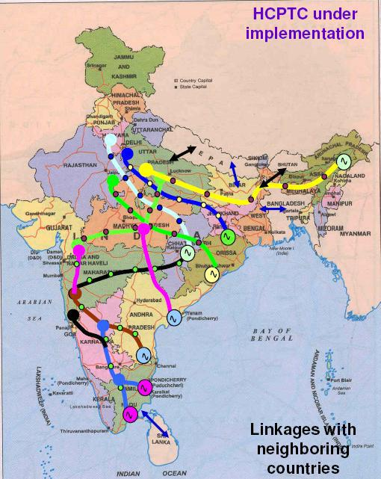
HCPTC under implementation

